Slide 1
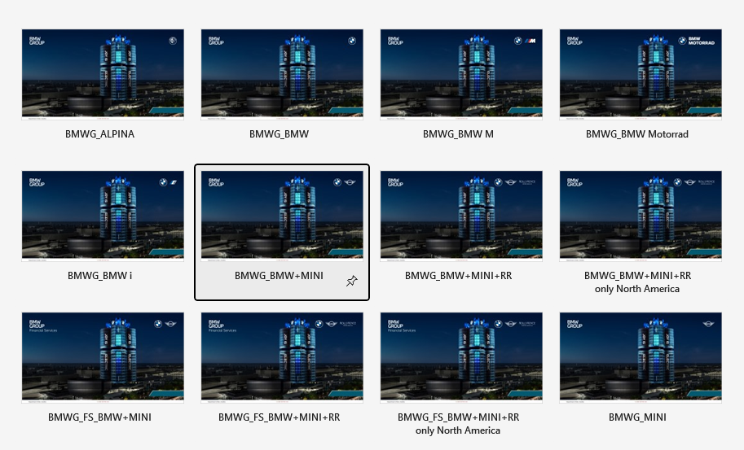
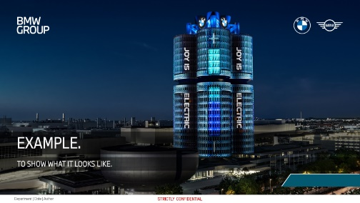


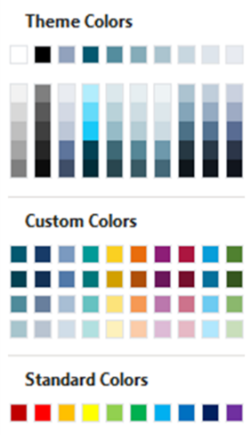

Relevant user information.
Please find additional Masters – for different sender designations – in PowerPoint – file – new…
The blank space is reserved for the Azure Information Protection confidentiality signature which has to be visible on all slides.
(Templates)
BMW GROUP
With °PowerOn you can easily edit the footer via the function “FOOTER”.
The ribbons °PowerOn, °Gallery and °Chronos offer additional support, e.g. by inserting example slides with just on click.
Ocean Blue and its tones is our main fill and line colour.
If you use text on coloured areas, please ensure a good legibility with high contrast.
Get PowerOn @ WUSS Find more information here.
White text
Black text

Slide 2
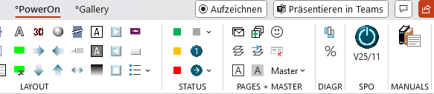
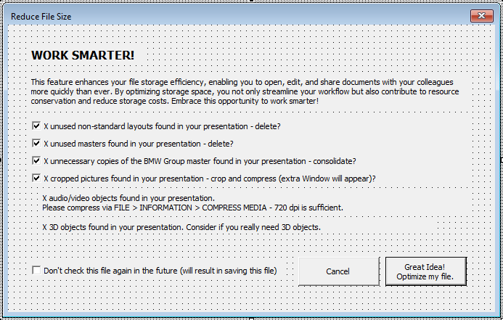



New features in PowerOn.
From now on, PowerOn will help you with your file management.
As you choose the new button, PowerOn automatically checks your file for unnecessary layouts, masters, images, audio/video files and 3D elements, and suggests you clean them up.
If nothing is found, the form is directly closed again with a short message.
This often helps reduce file size and save storage space.
You can customize or disable these checks as needed.
Watch a 5 minutes video about how to use our CI creatively.
Find Pictures for Title Slides in DAM.
Use only official imagery DAM, Pressclub
In some cases your Title Slide can get reset to Petrol. Just delete the Petrol Placeholder. Your picture is behind.

Slide 3


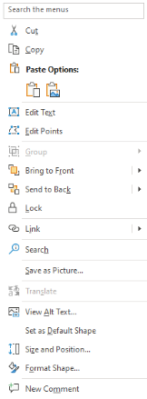


improve the visibility of our logos...
News
…with the PowerPoint-Add-In PowerOn.
!
Select and right mouse click
If your title picture is too bright or the logos are not well recognized for other reasons, simply insert a transparent darkening gradient via PowerOn.
The gradient can be edited if necessary.
✓
Please then bring the darkening gradient and the image to the background or the logos to the foreground.
Please find a video tutorial for gradient here. Get PowerOn @ WUSS and more information about it here.

